Slide 1

MooMarket
1905009 – Sidratul Muntaha Khan
1905010 – Md. Muhaiminul Islam Nafi
1905020 – Gazi Fardin Zafor Suvro
1905021 – Sakib Mohammed Sobaha
1805017 – Rizvan Jawad Ruhan
1805066 - Najmus Sakib Rashid

Slide 2
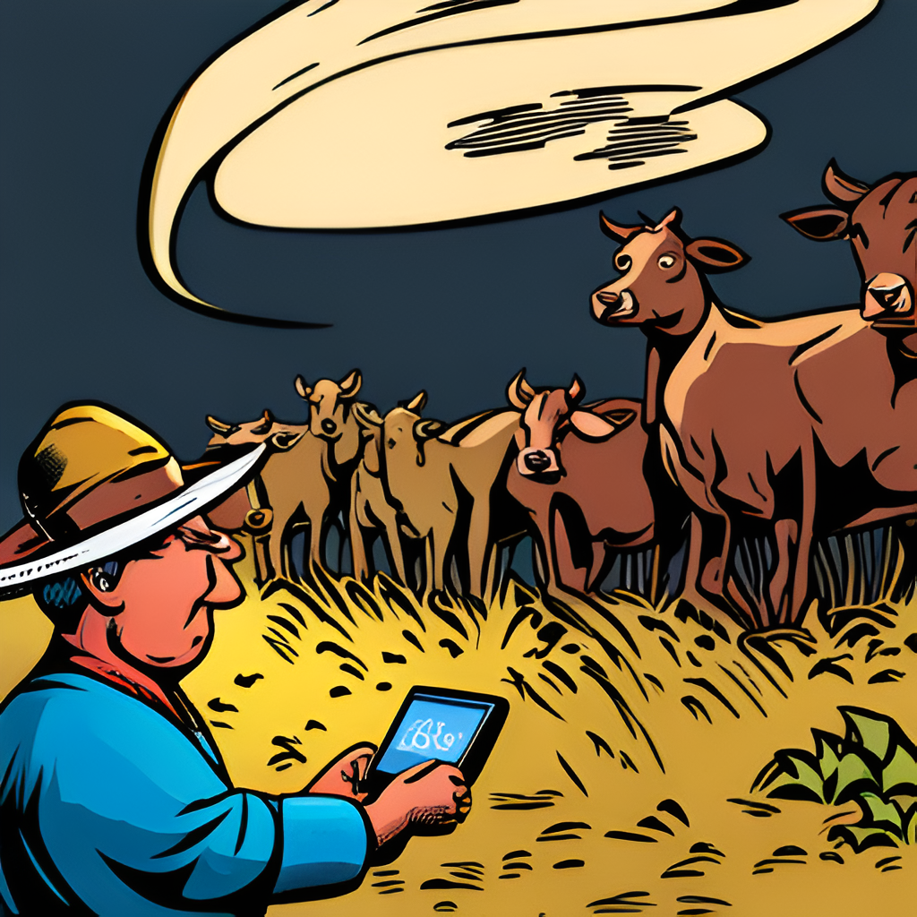
Introduction
Welcome to our presentation on the web platform for selling cattle and meat.
Any firm must have an online presence in the current digital era. This platform gives cattle and beef vendors a way to reach a larger audience and run their businesses more effectively.
Our site has an intuitive user interface that makes the purchasing and selling process easier. It is intended to speed up, simplify, and increase the security of transactions.
Buyers and sellers can communicate with one another on our platform from any location in the world.

Slide 3

Motivation
For creating the Cattle and Meat Selling web platform is to provide a better solution for sellers and buyers in the meat industry.
We believe that our platform can make a positive impact on the global meat market by providing a more efficient, transparent, and secure marketplace.
We are motivated by the potential for growth and expansion, as well as the opportunity to make a positive impact on the lives of farmers and consumers around the world.

Slide 4

Why use Web portal?
Sellers are limited to local buyers, which restricts their potential customer base.
The process of finding buyers is time-consuming and often involves middlemen, resulting in higher costs for sellers
There is no guarantee of payment or quality control, which can lead to disputes and loss of revenue.

Slide 5

Brief Overview
Communication
Bucher
General consumers
Horn Factory
Tannery Factory
Farmers
Agent Team
Vet Team

Slide 6
Modules
Primary Meat Processing(buying and selling) (Butcher to Consumer)
Unprocessed Tanner & horns and hoof Processing(buying and selling) (Butcher to Tannery & Horn factory)
Whole Cattle Processing(buying and selling) (Farmer to Butcher / Farmer to Consumer)
Notification setting for regular medicine taking
Vet service providing, prescribe medicine (Vet user)
Timeline, bookkeeping, profile maintenance (featured with module 1)
Quality checking, location verifying , Data Analysis and Trends (Agent user)

Slide 7
1.Butcher to consumer product flow
Processing will hold. Corresponding steps are:
Slaughtering
Dressing
Preparing the meat
Meat is divided into categories to allow consumers have a wide range of options.
Now product is stored in freezer and listed in the portal.
Consumers will order from our portal. The corresponding UI is given in the next slide.

Slide 8
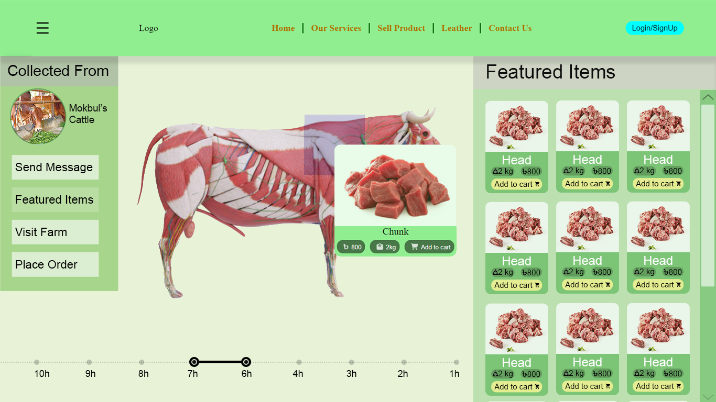

Slide 9
1.Butcher to Consumer Product flow
Once an order is placed butcher will get a notification and will prepare the ordered meat ensuring proper packaging to maintain freshness of the product.
The meat products are carefully transported to the consumers' specified addresses, maintaining proper temperature control if necessary.
Upon receiving the ordered meat products, consumers can verify the quality, freshness, and adherence to their preferences. They can provide feedback and ratings on the online portal, helping maintain transparency and accountability.

Slide 10
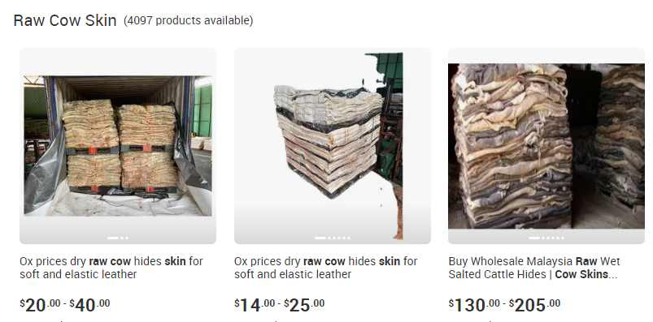

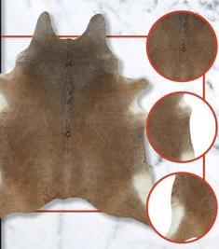
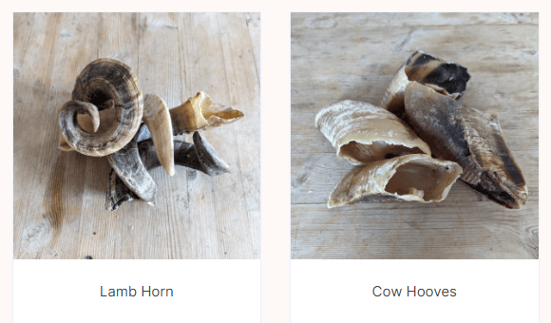
2.Butcher to tannery/horn business direct communication
Advertise and sell raw hides and horns online to tannery or Horn Manufacturing company respectively
Getting cattle parts at a fair price
Pricing done by specific conditions and algorithm
Annihilating the presence of syndicates in between Butchers and Tannery or other business

Slide 11
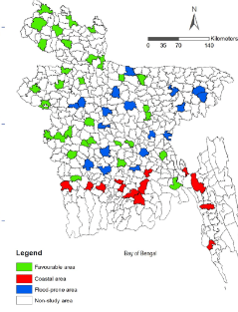
2.Butcher to tannery/horn business direct communication
Country wide connectivity between butchers and tannery/horn business
Butchers
Tannery
Horn business

Slide 12
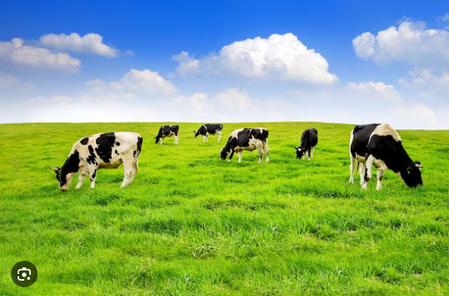


3. From farm to fork unveiling the Farmer-to-butcher process
Keeps track of livestock management essentials includes appropriate housing, feeding, and health issues.
Helps farmers to source livestock.
Suggests farmers feed and nutrition for ruminants.
Avoiding hassle caused by middleman.
Encourage farmers to ensure ethical practices for veterinary care.
Provides proper guidelines of slaughter and processing.
Perform proper analytics to avoid sudden price hike.
Timeline, bookkeeping, profile maintenance (Module 6)

Slide 13
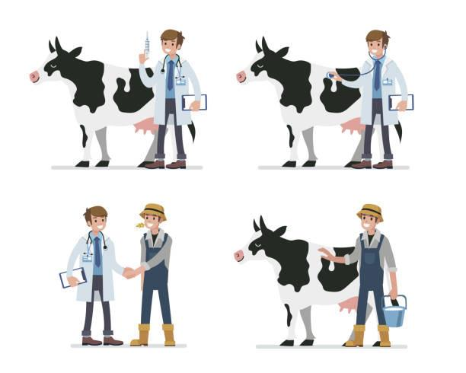
4. Modules(Notification sending for timely medicine taking)
HealthCare Maintained Timely
TimeLine Checking of every cow
Drug taking date is near of any one
Notify Farmers
Wait for their confirmation
Update Timeline

Slide 14
5.Vet service
Prescribing and Providing Medicine if Necessary
Regular Check Up via qualified Veterinarian
Health Quality of every Cattle maintained Properly
At time of any injury, instant support from vet team
Prevention of any flu expansion, resulting profit of farmers
More veterinarian will get opportunity
Vet plan initiative
Sole purpose to provide Halal products to customer
Reducing losses of farmers
Involving more quality veterinarian for service

Slide 15
7.QUALITY ASSURANCE
Quality Assurance Standards
Supplier Verification
Regular Inspections and Audits By Agents and Vets
Supplier Ratings & Reviews Based on customer feedback
Tracking the supply chain from farm to customer
Quality Control Check

Slide 16
Supplier verification Module
Supplier Registration :
collects necessary information, including business details, contact information, and documents
Automated Document Verification
Conduct Background Checks :
Integrate with third-party services or databases to check for any criminal records, regulatory violations, or previous complaints against the supplier.
Quality Assurance Standards :
Create a checklist or questionnaire that suppliers need to complete, covering aspects such as animal welfare practices, feed quality, hygiene, and processing standards.
Supplier Evaluation :
Develop a scoring or rating system to evaluate suppliers based on their adherence to quality standards.

Slide 17
Regular Monitoring module
Inspection Scheduling :
a scheduling feature with options for setting the inspection frequency based on risk levels or regulatory requirements.
Inspection Assignment :
Develop a system that allows inspectors to view their assigned inspections and receive notifications when new inspections are scheduled.
Inspection Checklist :
Enable inspectors to record their findings during the on-site inspection using a mobile app or a web-based form.
Corrective Action Management :
a module to track and manage corrective actions identified during inspections.
Provide reminders and notifications to ensure timely completion of corrective actions.
Schedule follow-up inspections for suppliers who have had significant violations or non-compliance issues.
Inspection History and Tracking :
Develop a scoring or rating system to evaluate suppliers based on their adherence to quality standards.
Data Analysis and Trends :
Analyze inspection data to identify trends, recurring issues, or areas where suppliers may need additional support or training.
Generate reports or visualizations that help in assessing overall compliance levels and identifying areas for improvement.

Slide 18
Tracking Module
Product Identification :
Assign unique identifiers (e.g., QR codes, barcodes, or serial numbers) to each batch or individual meat or cattle product.
Inventory Management :
Record the quantity, batch numbers, and associated product identifiers at each stage.
Shipping and Transportation :
record transportation details, such as carrier information, departure and arrival dates, and tracking numbers.
Real-time Tracking :
Implement a real-time tracking module that allows stakeholders to monitor the location and status of the products during transit.
Traceability Interface:
Create a user-facing traceability interface that enables customers to scan product identifiers (e.g., QR codes) and access detailed information about the product's journey.
Data Analytics and Reporting:
Implement data analytics and reporting capabilities to generate insights about the supply chain, such as average delivery times, delivery performance, and customer satisfaction.

Slide 19
Quality control check module
Quality Control Check Parameters :
Examples of parameters may include appearance, texture, color, odor, fat content, moisture content, and temperature.
Quality Control Checklist ( assessed for each product ) :
Include options to customize the checklist based on specific product types or quality requirements.
Regular Inspection , sample & Test Data :
Schedule inspections and enable quality control personnel to input data, record observations, and enter test results into the software platform.
Include options to specify the number of samples to be taken, sampling methods, and testing protocols.
Automated Data Analysis:
Develop algorithms or rules to analyze the collected data and identify any deviations or quality issues.
Non-Conformance Management:
manage non-conformances and quality issues identified during the quality control check.
Include options to create corrective and preventive action plans, assign responsibilities, and track the resolution process.
Integration with Supply Chain:
Enable quality control personnel to link quality control data with specific batches or lots of meat products for traceability purposes.

Slide 20
Features on sales history
SALES PERFORMANCE DASHBOARD
SALES SEGMENTATION
DATA EXPORT & INTEGRATION
COMPARATIVE ANALYSIS
CUSTOMER BEHAVIOR ANALYSIS
FORECASTING & DEMAND PLANNING
Notes:
+ ADVANCED SEARCHING & FILTERING

Slide 21

Future Opportunities
Virtual Reality (VR) Experience: Provide immersive experiences for customers. This could include virtual tours of cattle farms, meat processing facilities, and tanneries, allowing customers to gain a deeper understanding of the production process and make more informed purchasing decisions.
3D Visualizations of Tanning Process: Utilize 3D animations or visualizations to showcase the tanning process from start to finish. Customers can gain a better understanding of the intricate steps involved in transforming raw hides into finished leather products.
IoT Integration for Real-Time Tracking: Integrate IoT (Internet of Things) devices, such as RFID tags or sensors, to track the temperature, humidity, and other environmental conditions of meat products during transportation. Customers can access real-time data to ensure the freshness and quality of the products they purchase.

